Slide 1
A
presentation on
“AWS Cost Reduction System”
By:
1.Nikita Barade .
2.Harshal Chaudhari .
3.Ganesh Anarase .
4.Kiran Raut .
Guided By:
Prof. M.E.Sanap.

Slide 2
Introduction
Cost optimization is a major concern in cloud computing as owners of large IT infrastructures have to pay a large cost for resource utilization.
The infrastructure resources of cloud computing can be widely distributed in different phases according to the needs of different users.
In the course of a cloud, implementation users have the flexibility to choose the EC2 instance type that provides the appropriate mix of resources for the target application and workload.
The charges are applied on the basis of resource utilization, but it is very high as most of them not used in an effective way.

Slide 3
Introduction
The main purpose of the system is to create private cloud (test bed) by using (Amazon Account) along with monitoring critical resources like RAM, CPU, memory, bandwidth, partition information, running process information and utilization and swap usages etc.
Also, recommend the price reduction strategy. The system also enables optimum utilization of cloud resource.

Slide 4
Motivation
The infrastructure resources of cloud computing can be widely distributed in different phases according to the needs of different users.
In the course of a cloud implementation users have the flexibility to choose the EC2 instance type that provides the appropriate mix of resources for the target application and workload.
The charges are applied on the basis of resource utilization but it is very high as most of them not used in an optimal way.
The main purpose of the system is to create private cloud test bed by using Amazon Account along with monitoring critical resources like RAM CPU memory bandwidth partition information running process information and utilization and swap usages etc Also recommend the price reduction strategy

Slide 5
Problem Statement
To implement a scheme i.e. Cost Effective Resource Provisioning Approach for Cloud Environments to reduce the infrastructure cost of cloud usage and evaluate the performance of workloads on EC2 instances.

Slide 6
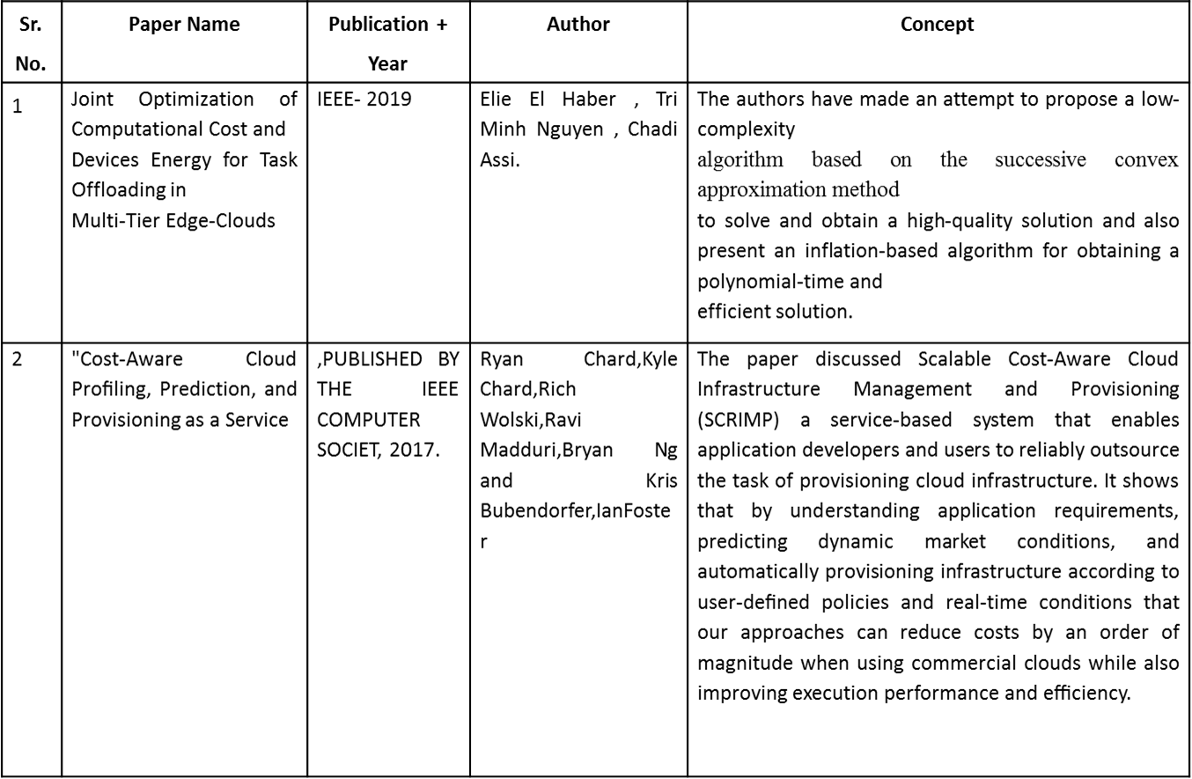
Literature Survey

Slide 7
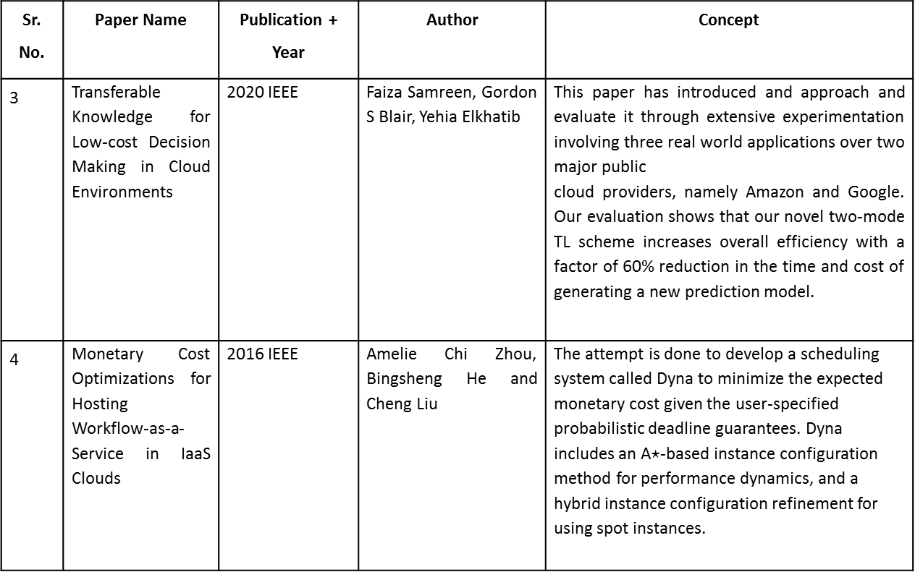
Literature Survey

Slide 8
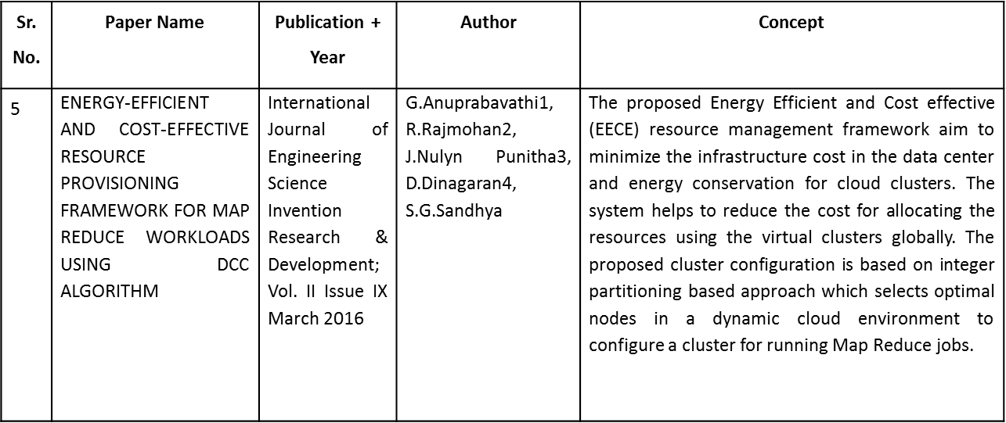
Literature Survey

Slide 9
Software Requirement
• IDE : Eclipse Luna
• Database : MYSQL
• Platform : Microsoft Windows 7 Professional or greater
• Language : Java JDK 1.8

Slide 10
Hardware Requirements
• Processor : 1 gigahertz (GHz) or faster processor or SoC.
• RAM : 1 gigabyte (GB) for 32-bit or 2 GB for 64-bit.
• Hard Disk Space: 16 GB for 32-bit OS 20 GB for 64-bit OS)

Slide 11
Project Scope
The proposed system which can monitor VMs (EC2 Instances) on private clouds such as Amazon or Google and offers solutions to decrease infrastructure cost. Resource Monitoring of Cloud Nodes:
1. Cloud Setup - Creating private cloud (test bed) by using (Amazon Account).
2. Resource Monitoring - monitoring critical resources like RAM, CPU, memory,
bandwidth, partition information, running process information and utilization and swap usages etc.

Slide 12
Project scope
3. Authentication and authorization – we need to connect to existing user’s amazon account using user id and password and fetch all the performance matrix like CPU, RAM, storage etc.
4. Testing - In order to evaluate the performance of complete setup, need to deploy resource monitoring and load balancing tools on test bed and evaluate need of available resources.
a. Resource Monitoring Tools : Openmanager, Spiceworks, Zabbix etc.
b. Load balancing Tools : ZEVENT, Nginx etc.

Slide 13
ASSUMPTION AND DEPENDENCIES
1.Assumptions
User must have basic knowledge of computer.
User must have basic knowledge of handling Web Pages.
Must be familiar basic with Networking and communication.
Admin only the user who is allowing to access network.
2.Dependencies
Only Administrators will be able to edit main configurations.
User and Administrators will communicate among themselves while executing the application.
Escalation mechanism is limited to administrator only.

Slide 14
Modules
1. Resource Monitoring of Cloud Nodes:
a. User should be able to view CPU and RAM usage utilization of amazon ec2 nodes
b. CPU and RAM utilization statistics should be dynamic and should refresh every second.
2. Select Cloud Plans
For popular clouds like amazon, cost of service depends on region of server, memory usage, CPU etc. Cloud service providers charge for following services which need to be added in system
a. Storage – Pricing
b. Request Pricing
c. Storage Management Price
d. CPU pricing

Slide 15
Modules
3. Monitor account wise VM Usage of following parameters
a. CPUUtilization
b. DiskReadBytes
c. DiskWriteBytes
d. NetworkIn
e. NetworkOut
f. StatusCheck
4. Propose efficient resource utilization
a. By suggesting memory cutdown
b. By suggesting cpu cutdown
c. By suggesting storage cutdown

Slide 16
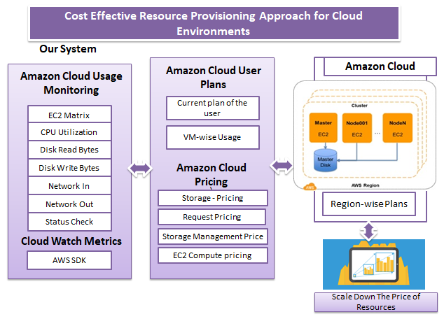
Architecture

Slide 17
Algorithms
AES Algorithm:
AES is based on a design principle known as a substitution-permutation network, and is fast in both software and hardware.
The key size used for an AES cipher specifies the number of repetitions of transformation rounds that convert the input, called the plaintext, into the final output, called the cipher text. The number of cycles of repetition are as follows:
1. 10 cycles of repetition for 128-bit keys.
2. 12 cycles of repetition for 192-bit keys.
3. 14 cycles of repetition for 256-bit keys.
b. SVM Algorithm:
SVM is a powerful classifier that is able to distinguish two classes. SVM classifies the test image in to the class with highest distance up to the neighboring point in the training.
SVM training algorithm built a model that predict whether the test image fall into this class or another.
SVM necessitate a vast training data to decide a decision boundary and computing cost is very high although we are using single pose (frontal) detect

Slide 18
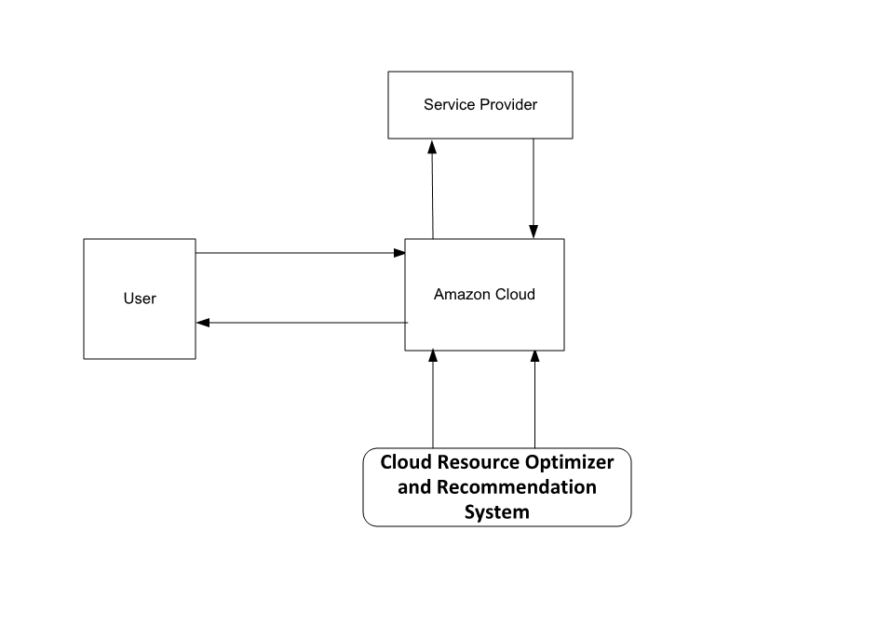
DFD LEVEL 0

Slide 19
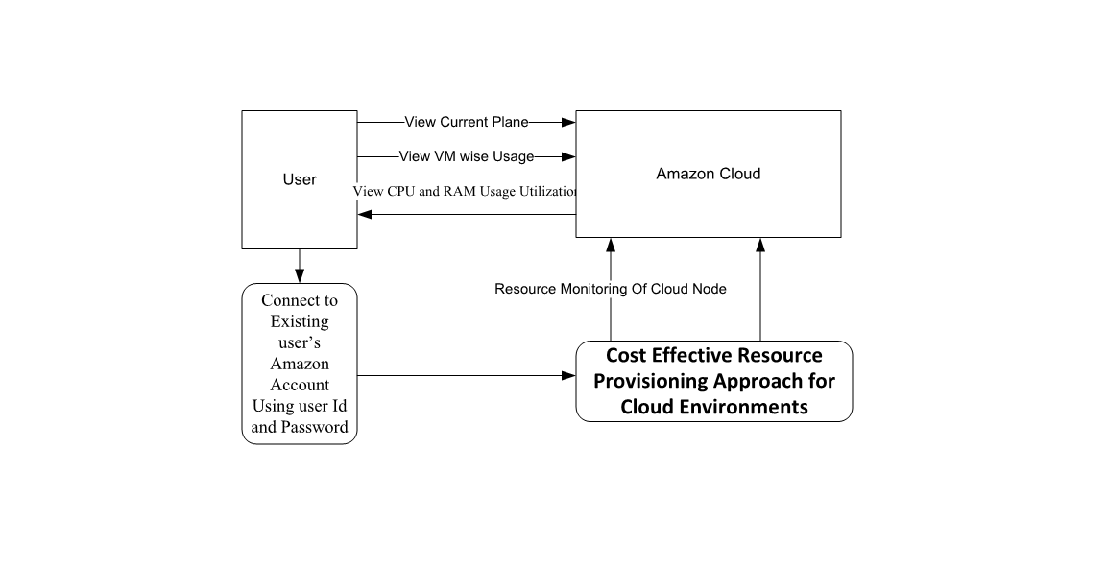
DFD LEVEL 1

Slide 20
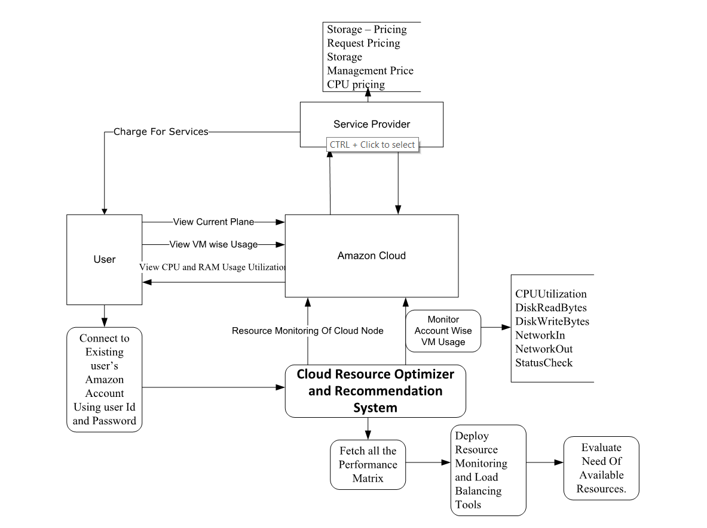
DFD LEVEL 2

Slide 21
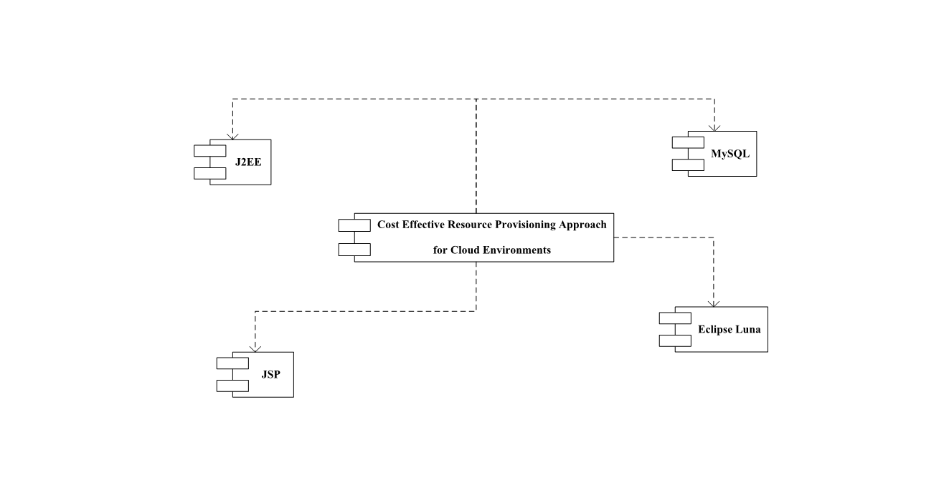
UML DIAGRAMS 1.Component Diagram

Slide 22
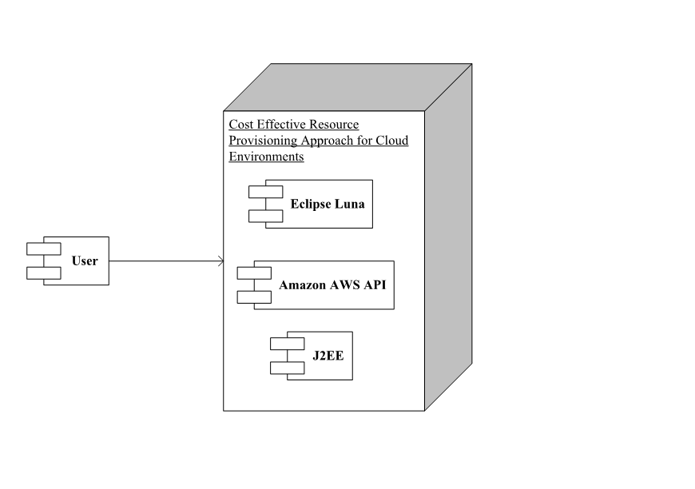
2.Deployment Diagram

Slide 23
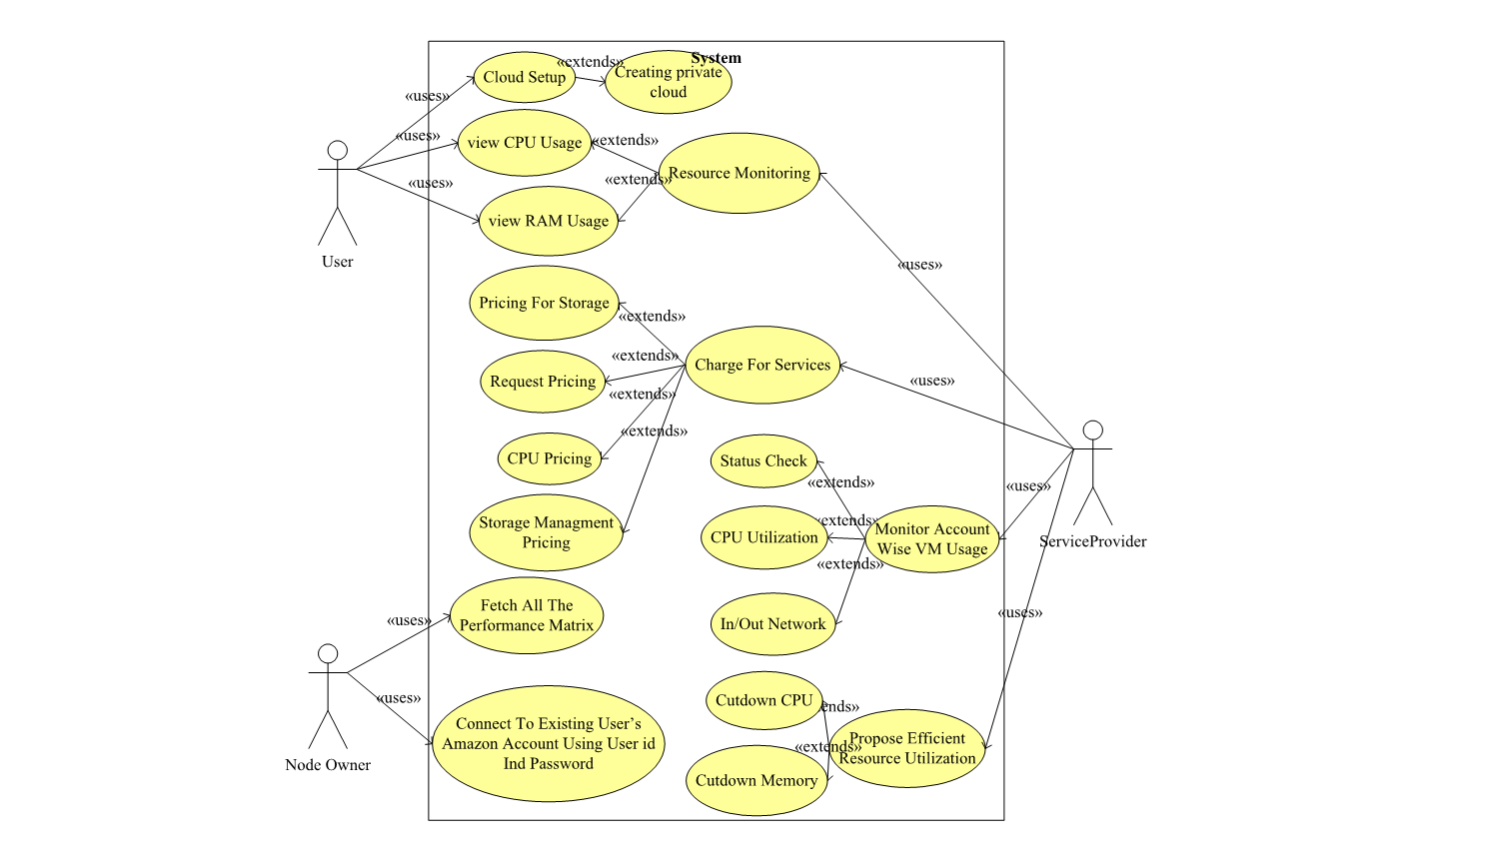
3.Use Case Diagram

Slide 24
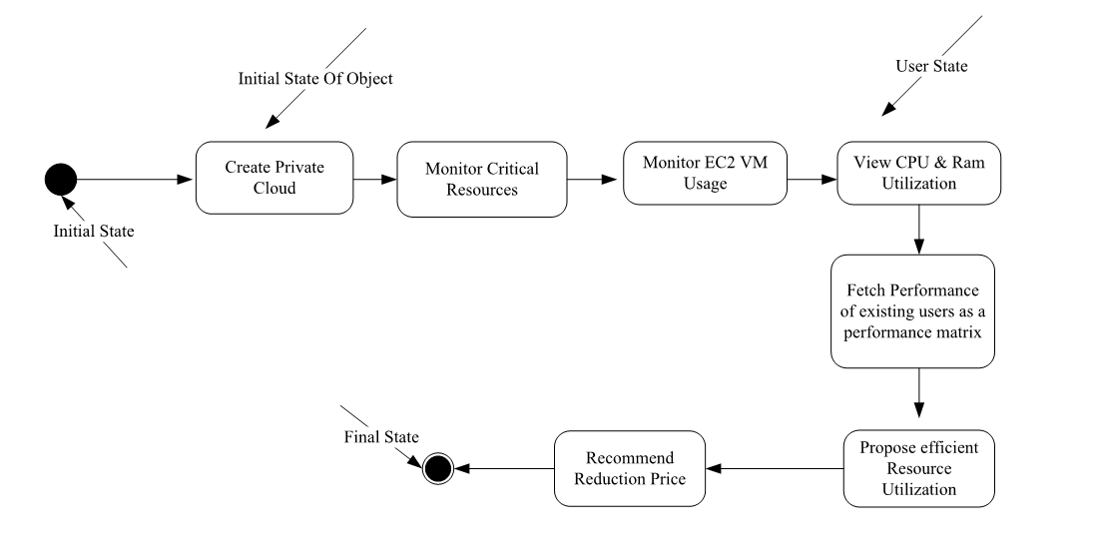
4.State Diagram

Slide 25
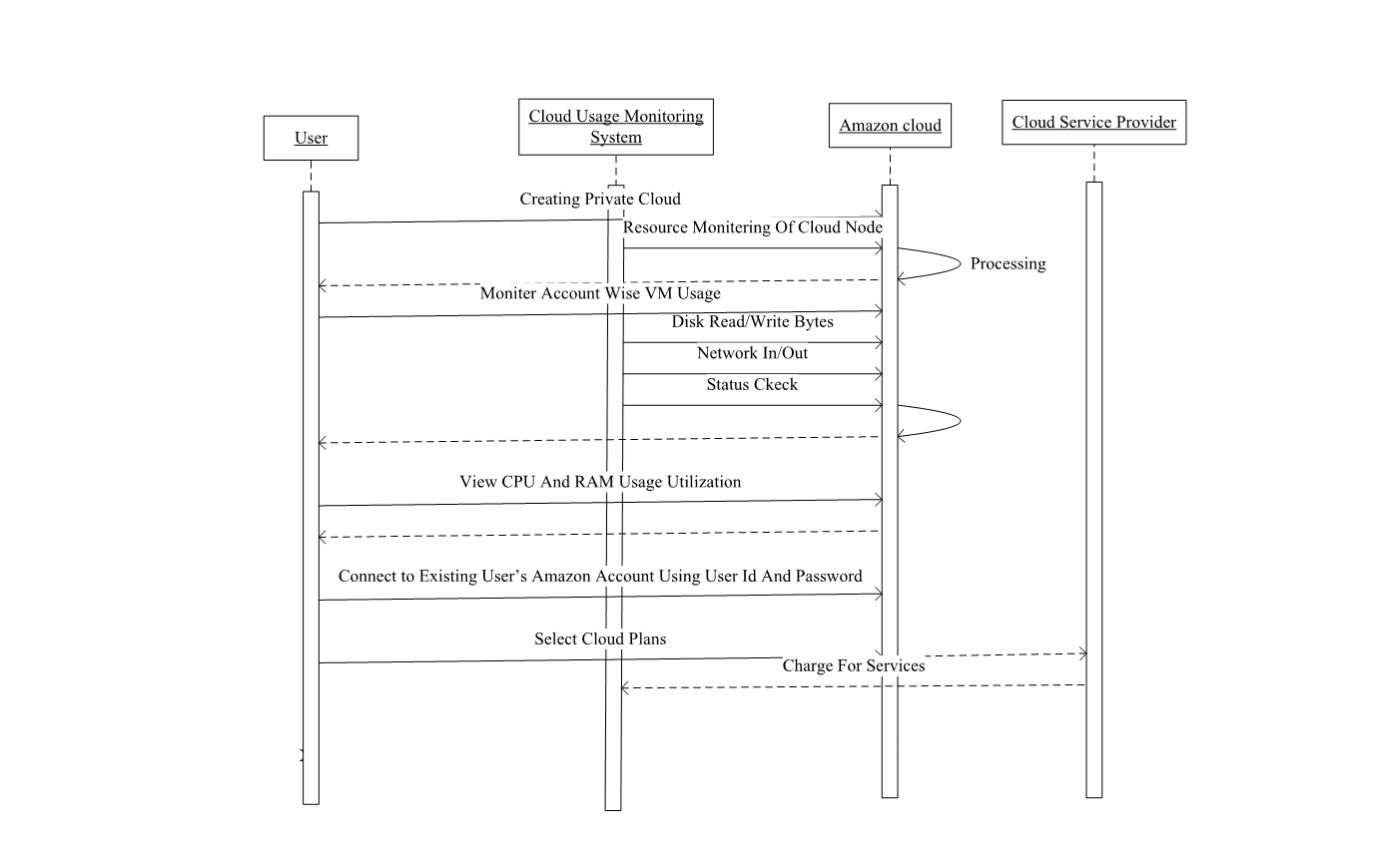
5.Sequence Diagram

Slide 26
Applications
1. The application is used for providing suggestions about cost optimization and delivering cost containment.
2. Used in monitoring and analyzing cost pattern on cloud accounts.

Slide 27
References
Ryan Chard,Kyle Chard,Rich Wolski,Ravi Madduri,Bryan Ng and Kris Bubendorfer,IanFoster,"Cost-AwareCloudProﬁling,Prediction,andProvi- sioning as a Service", PUBLISHED BY THE IEEE COMPUTER SOCIET, 2017.
Xinhui Li, Ying Li, Tiancheng Liu, Jie Qiu, Fengchun Wang,"The Method and Tool of Cost Analysis for Cloud Computing",2009 IEEE International Conference on Cloud Computing.
G.Anuprabavathi1, R.Rajmohan2, J.Nulyn Punitha3, D.Dinagaran4, S.G.Sandhya ,“ENERGY-EFFICIENT AND COST-EFFECTIVE RESOURCE PROVISIONING FRAMEWORK FOR MAP REDUCE WORKLOADS USING DCC ALGORITHM”, International Journal of Engineering Science Invention Research & Development; Vol. II Issue IXMarch2016.
Amelie Chi Zhou, Bingsheng Heand Cheng Liu Nanyang Technological University "Monetary Cost Optimizations for Hosting Workﬂow-as-a-Service in IaaS Clouds", IEEE TRANSACTIONS ON CLOUD COMPUTING, VOL. X, NO. X, AUGUST 2014

Slide 28
THANK
YOU

